Slide 1
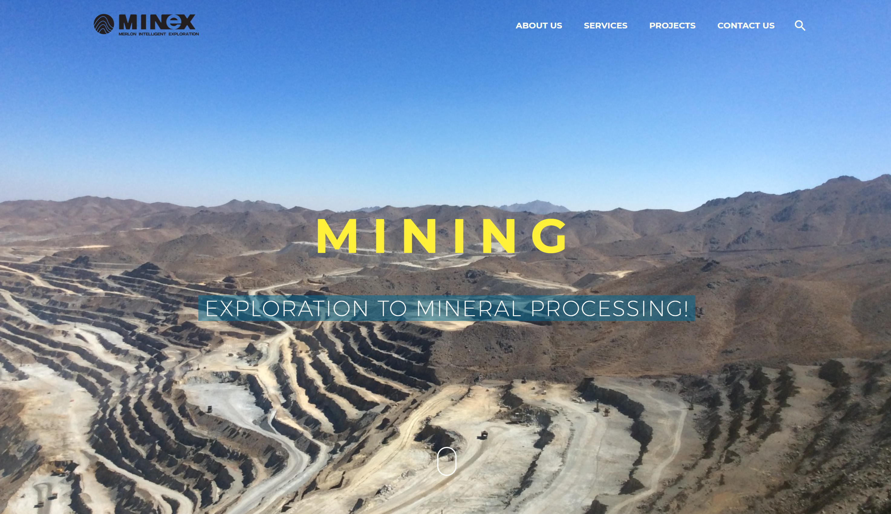
Exploration of covered and depth porphyry deposites

Slide 2
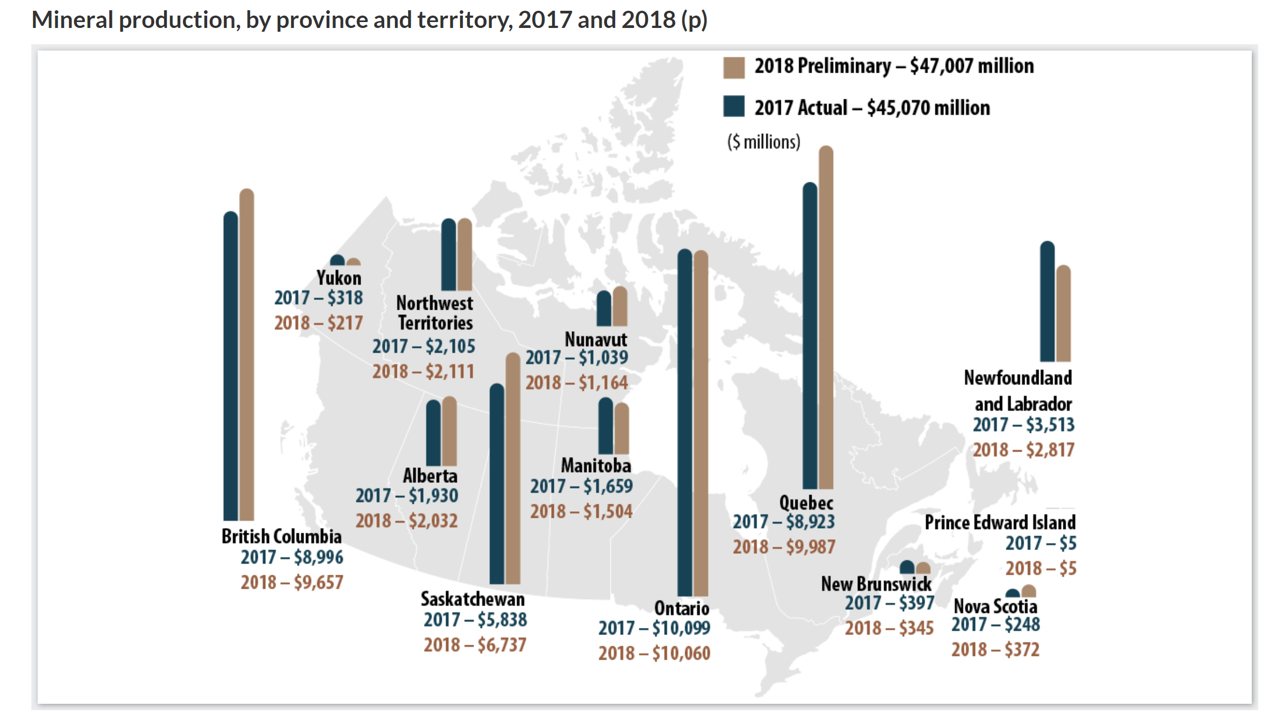
British Columbia

Slide 3
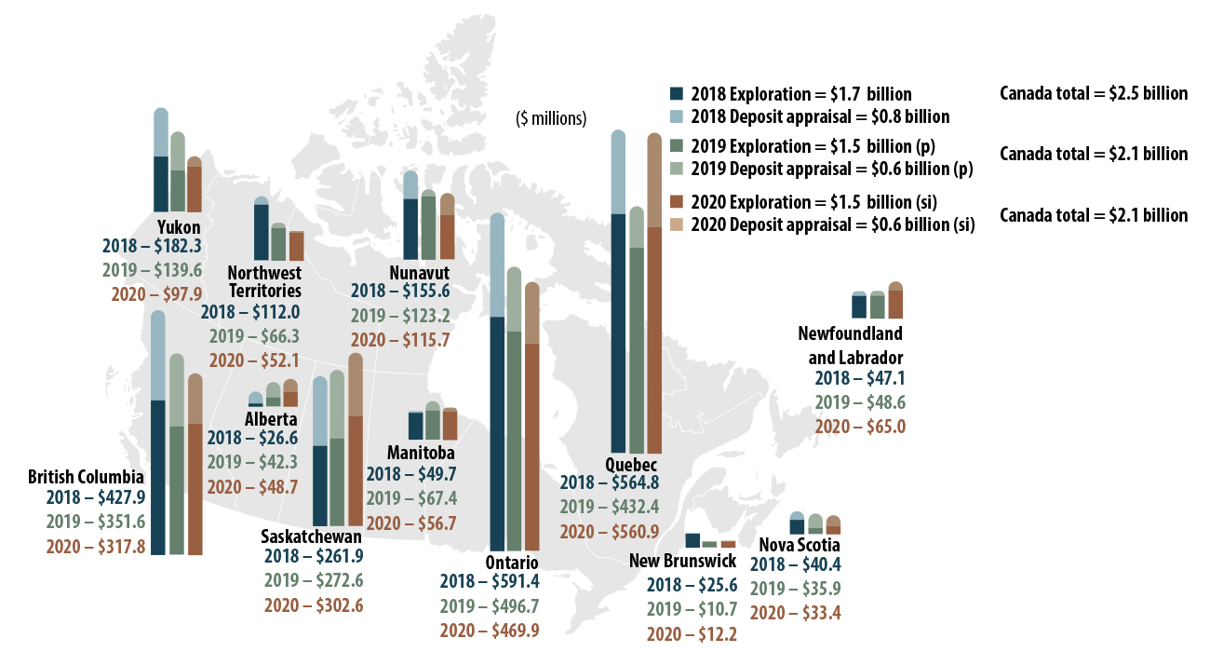
British Columbia

Slide 4
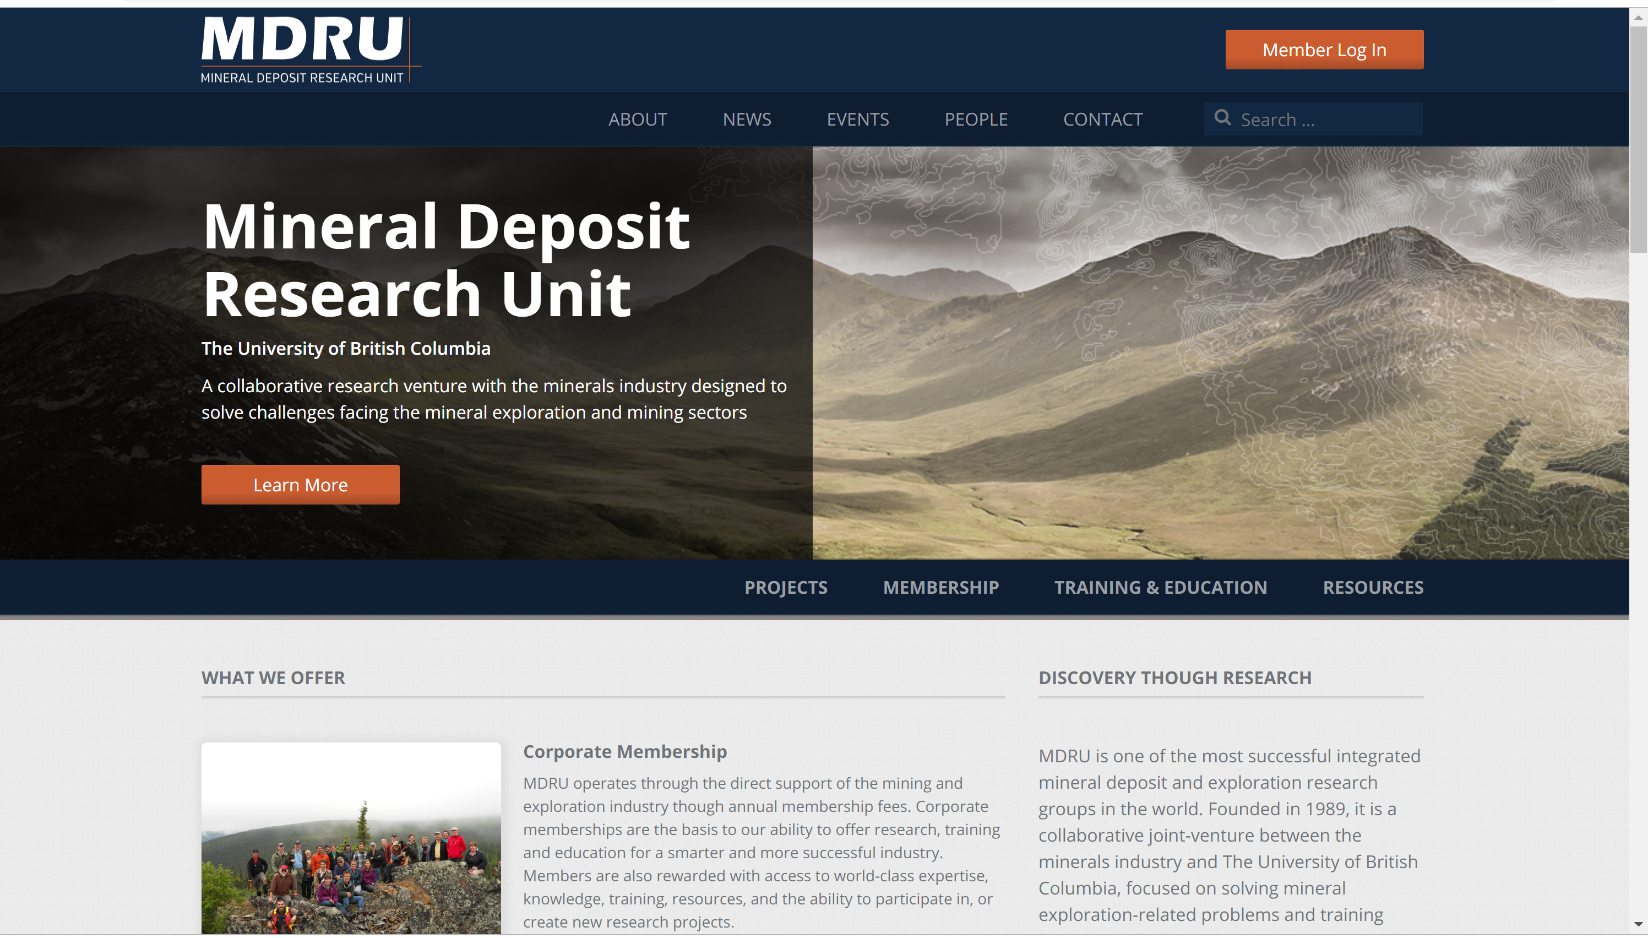

Slide 5




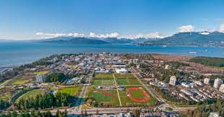

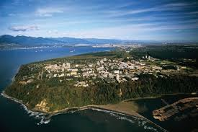

Slide 6
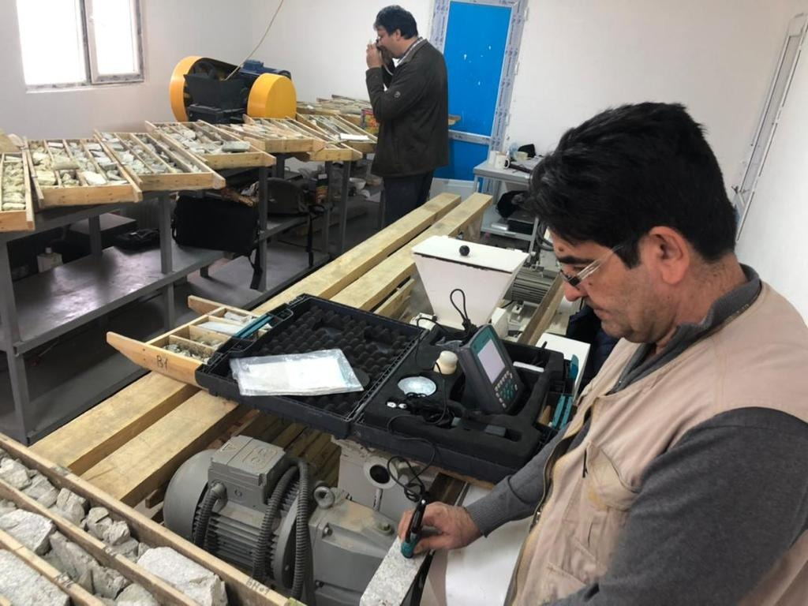

Slide 9
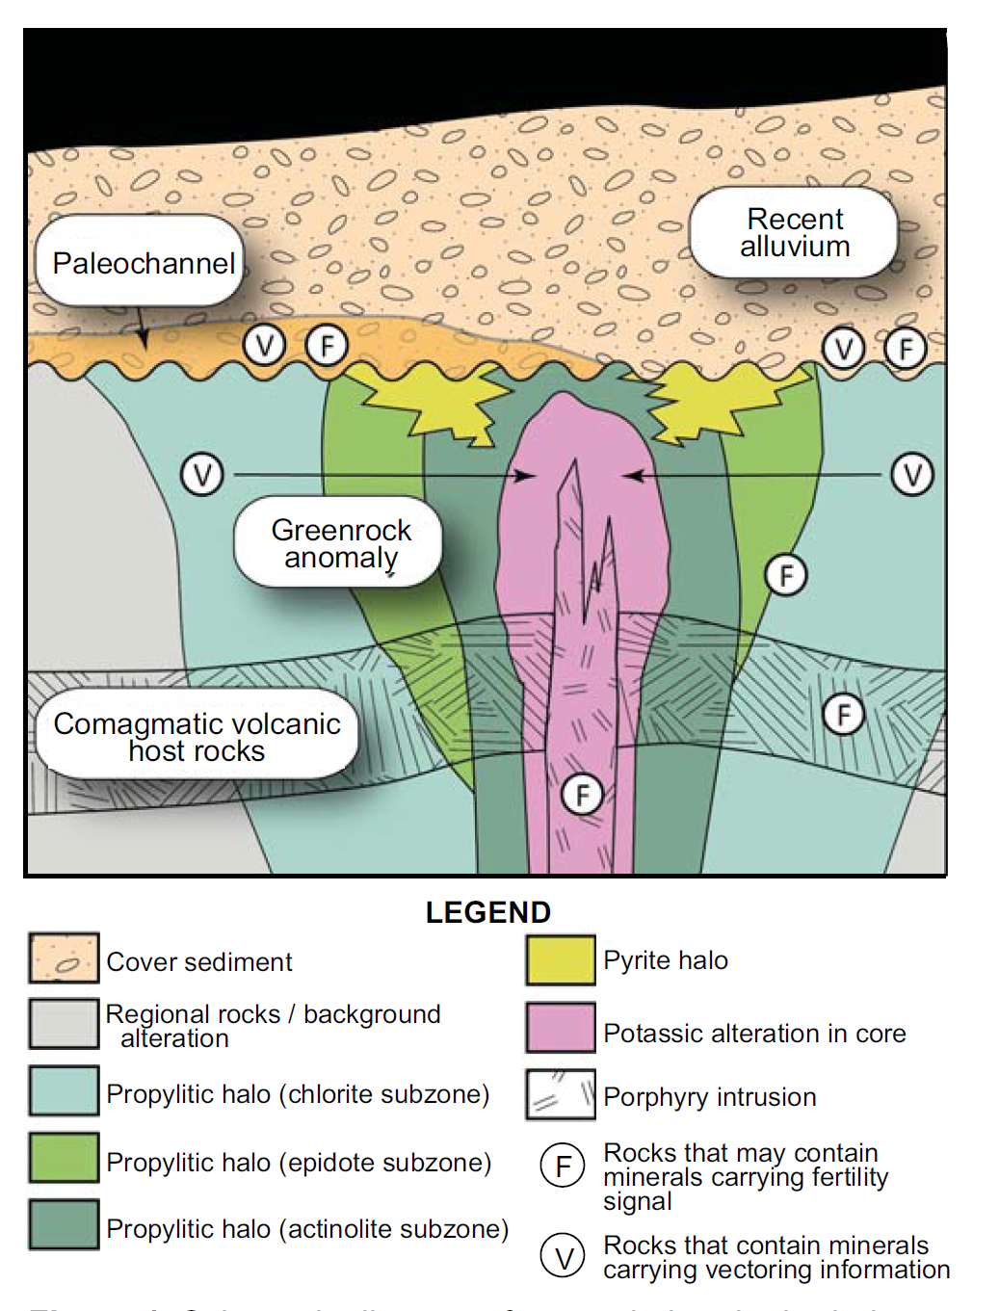
Exploration of covered and depth porphyry deposites

Slide 10
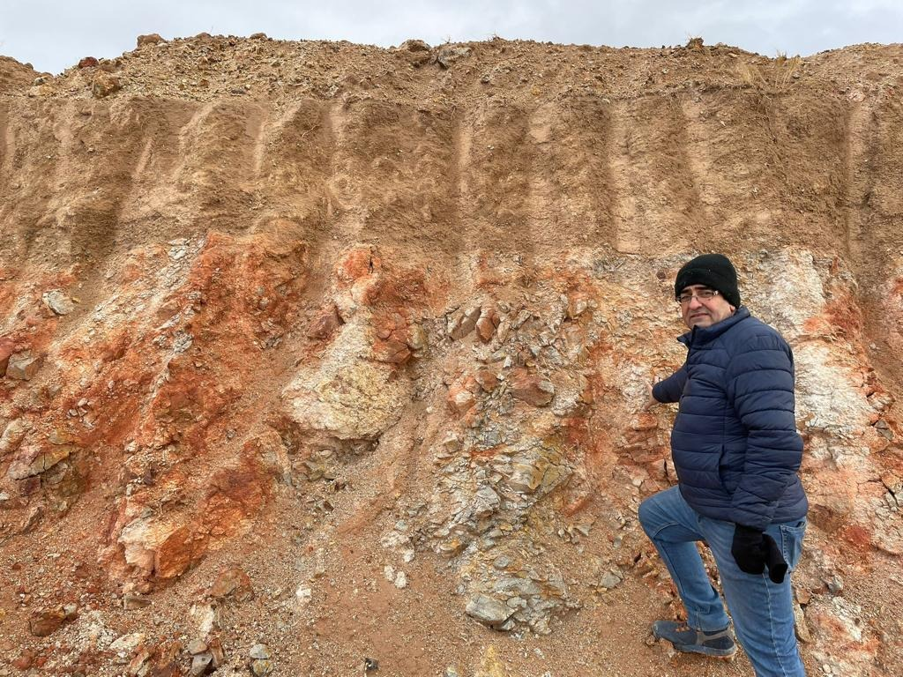
Exploration of covered and depth porphyry deposites

Slide 11
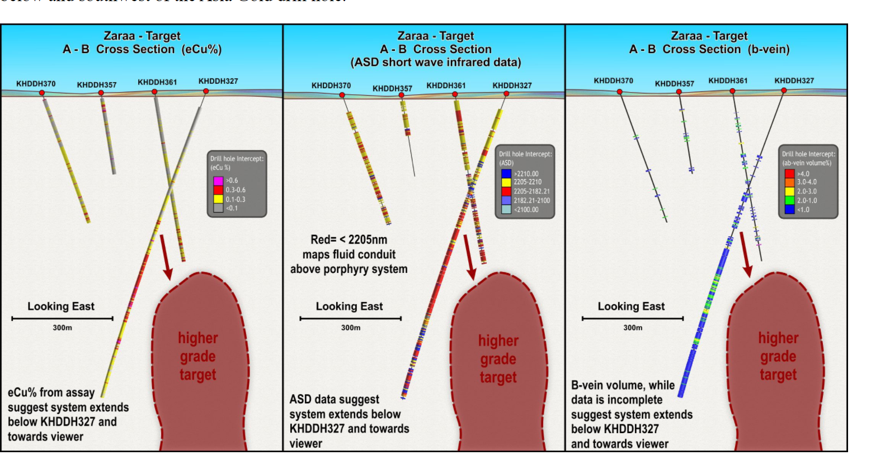

Slide 12
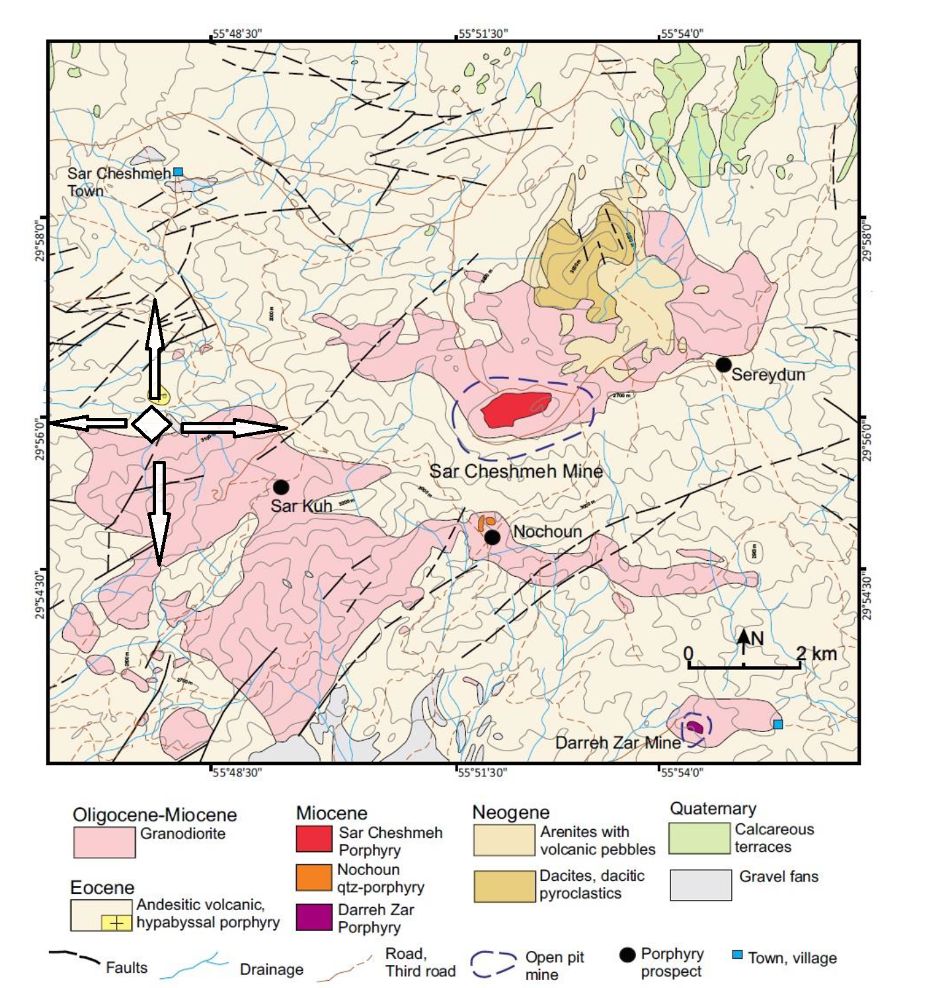

Slide 13
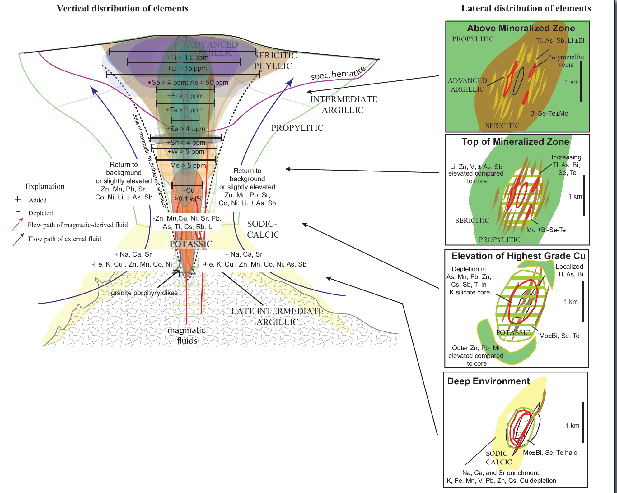
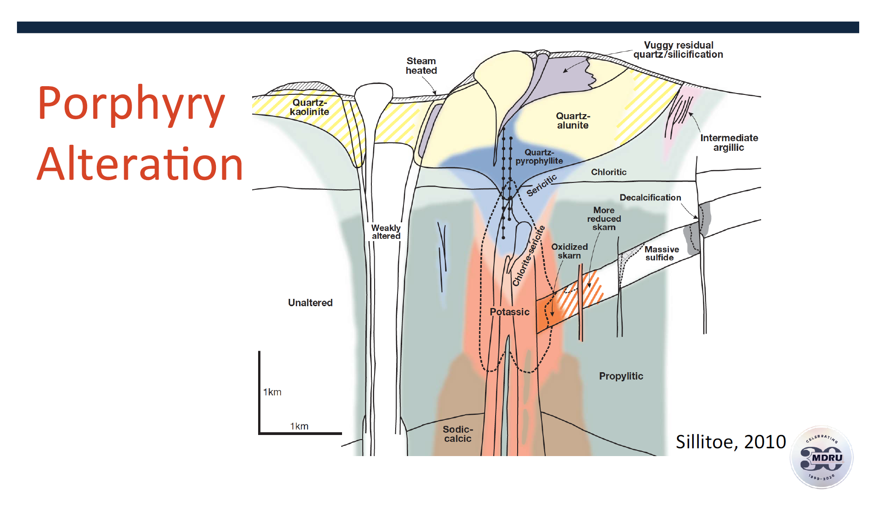
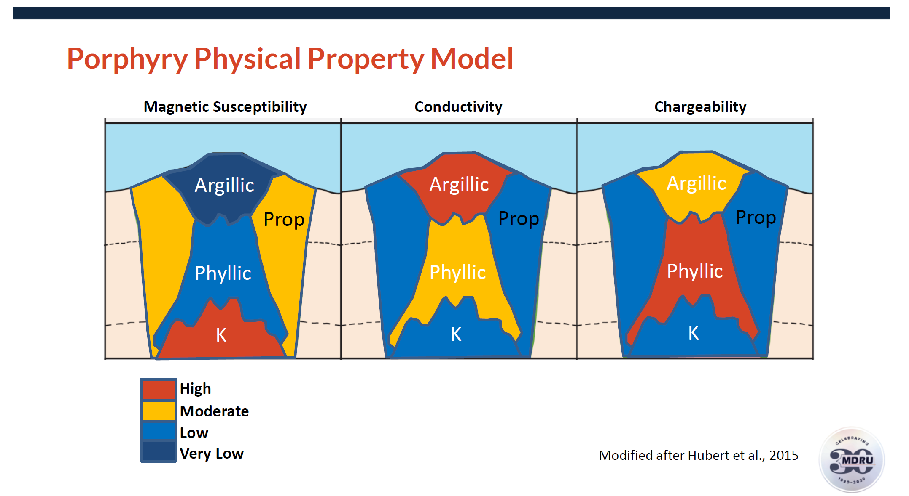

Halley et all.2015
$$+$$
OUR EXPERIENCES

Slide 16

FOOTPRINTS

Slide 17
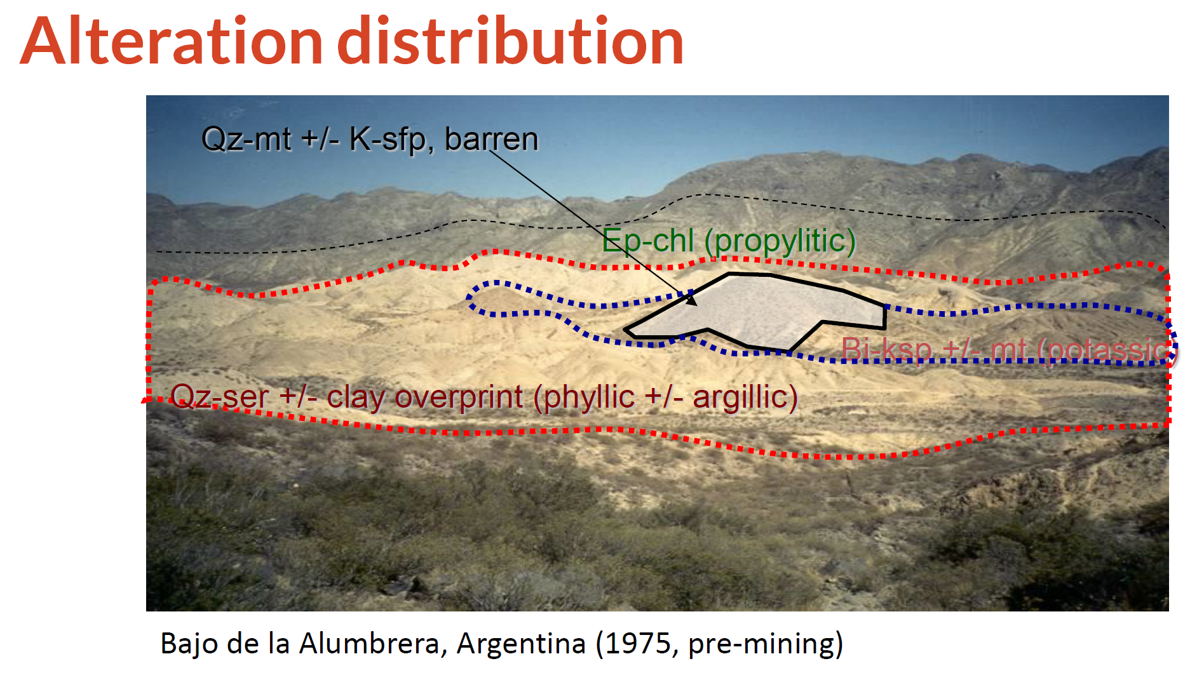

Slide 18
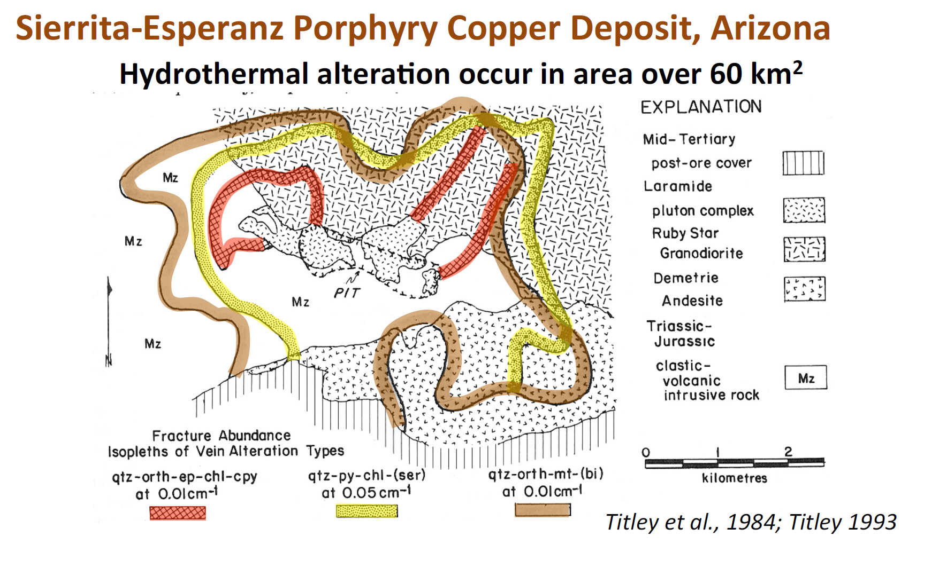

Slide 19
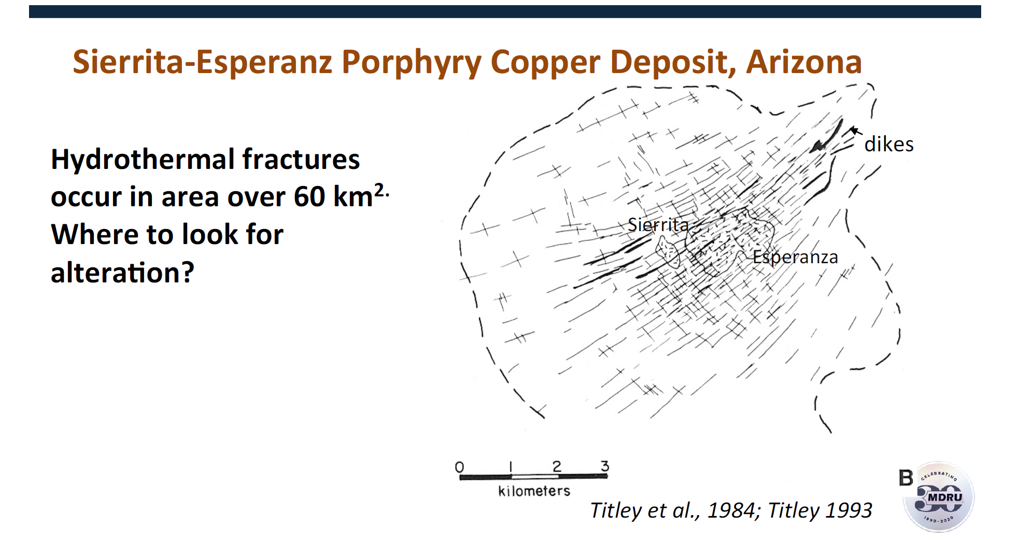

Slide 20
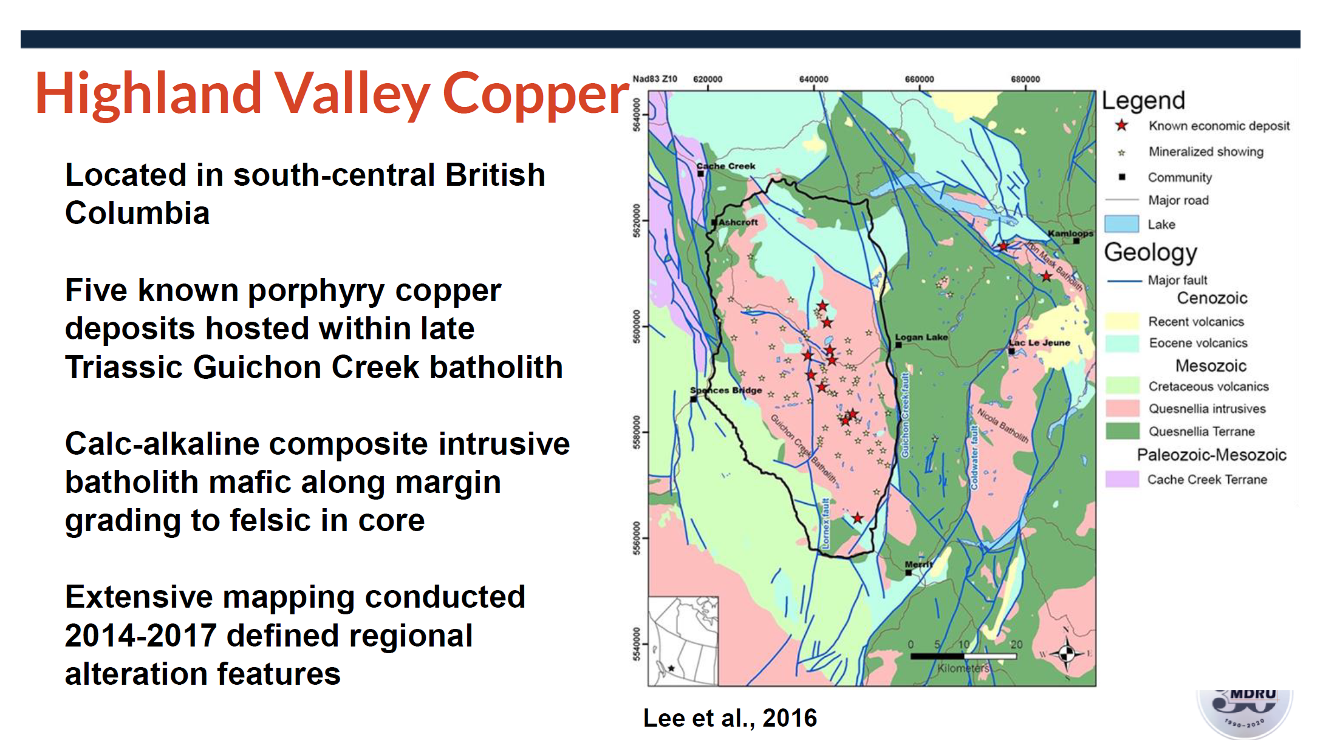

Slide 21
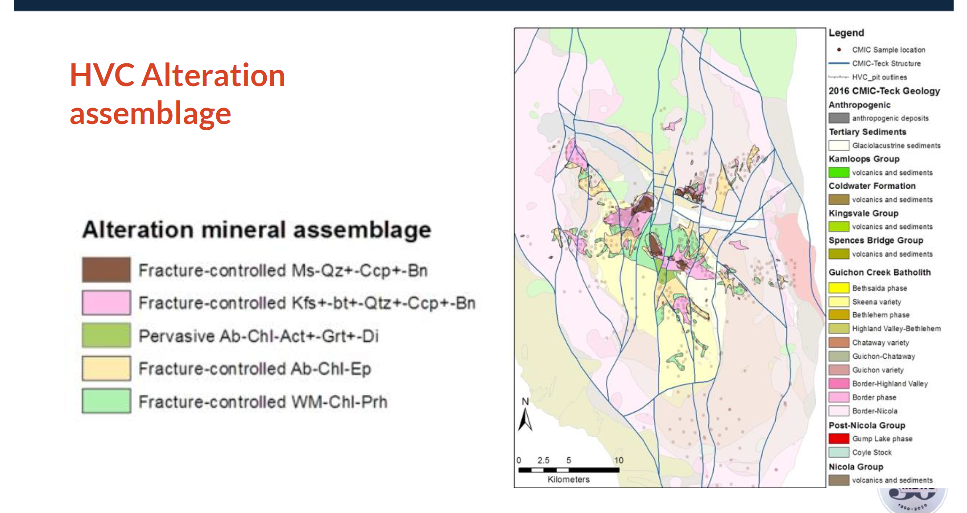
HVC Alteration assemblage

Slide 22
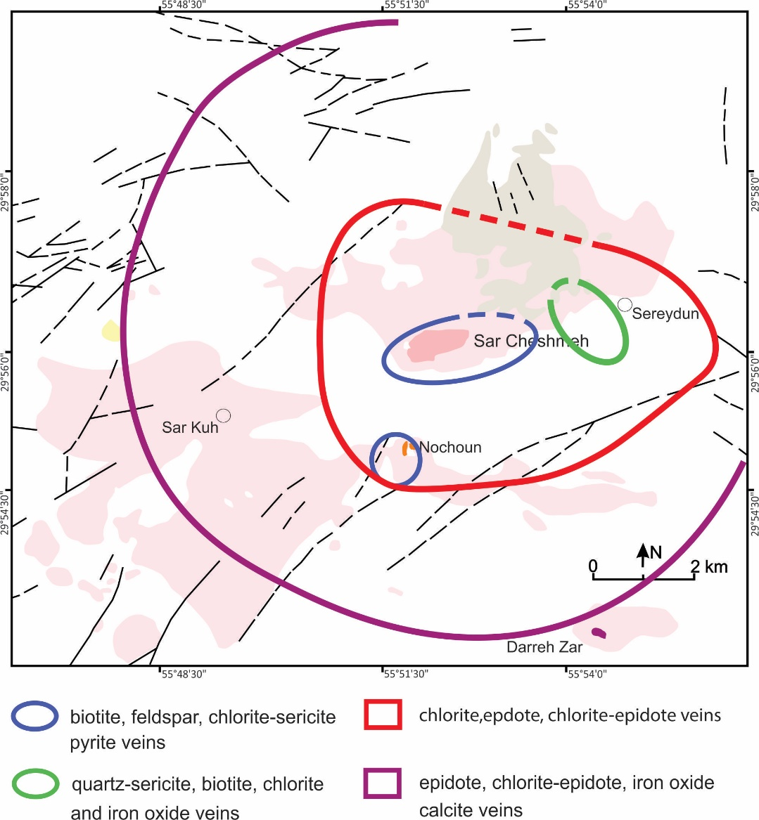
Aletaha et al. (2017)

Slide 23
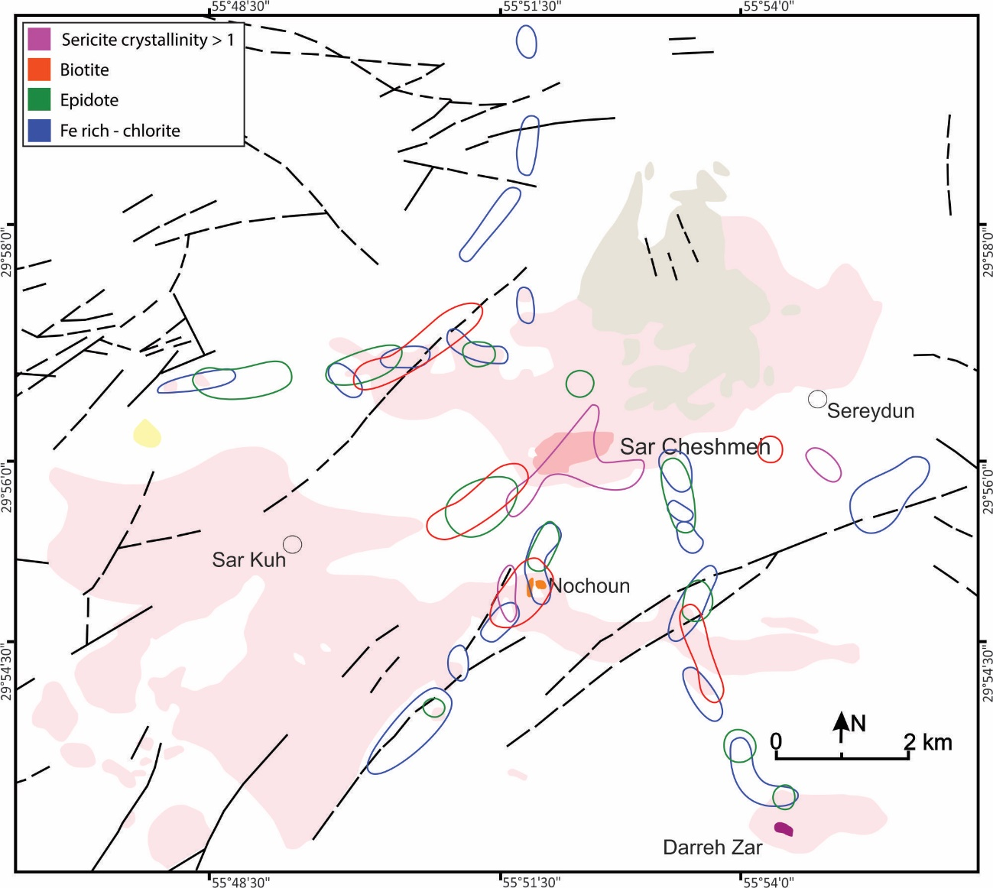
Aletaha et al. (2017)

Slide 24
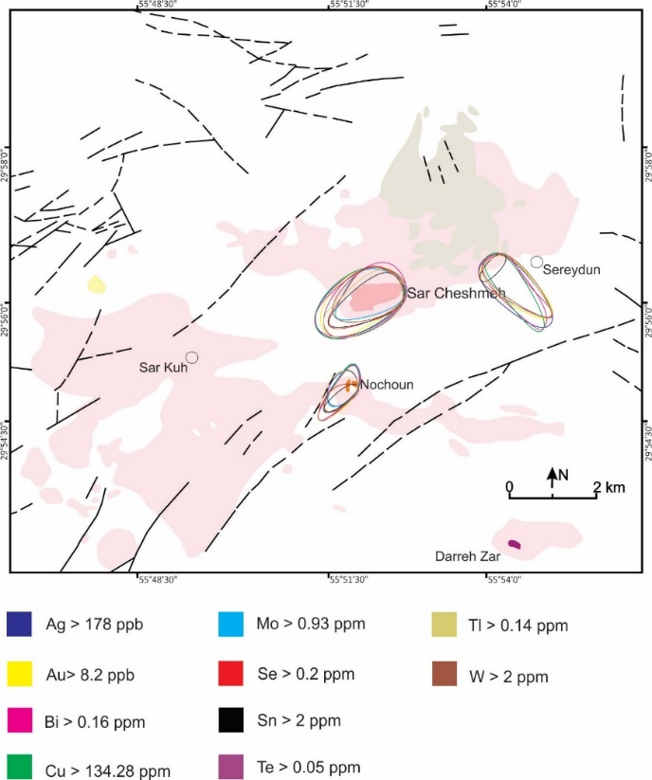
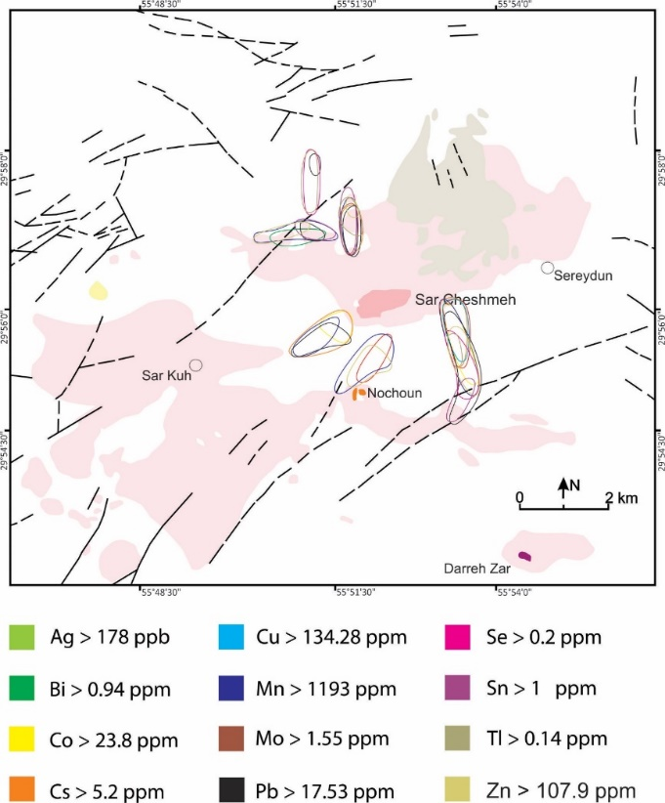
Aletaha et al. (2017)

Slide 25
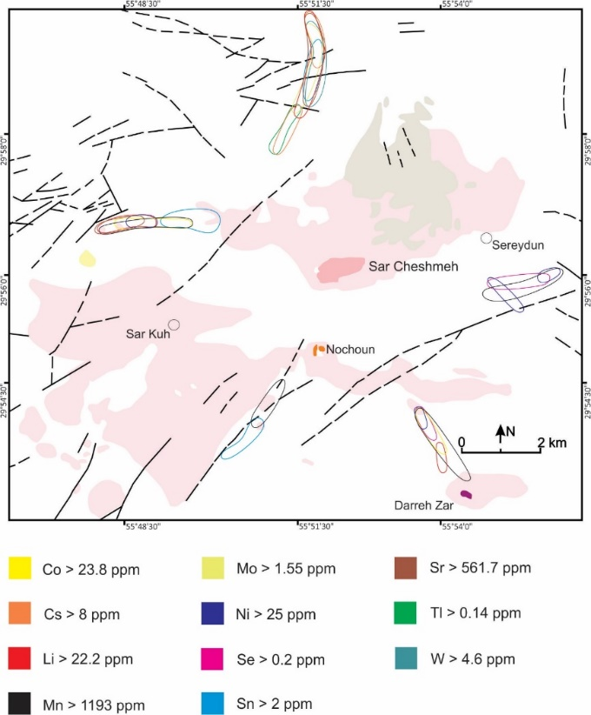
Aletaha et al. (2017)

Slide 26
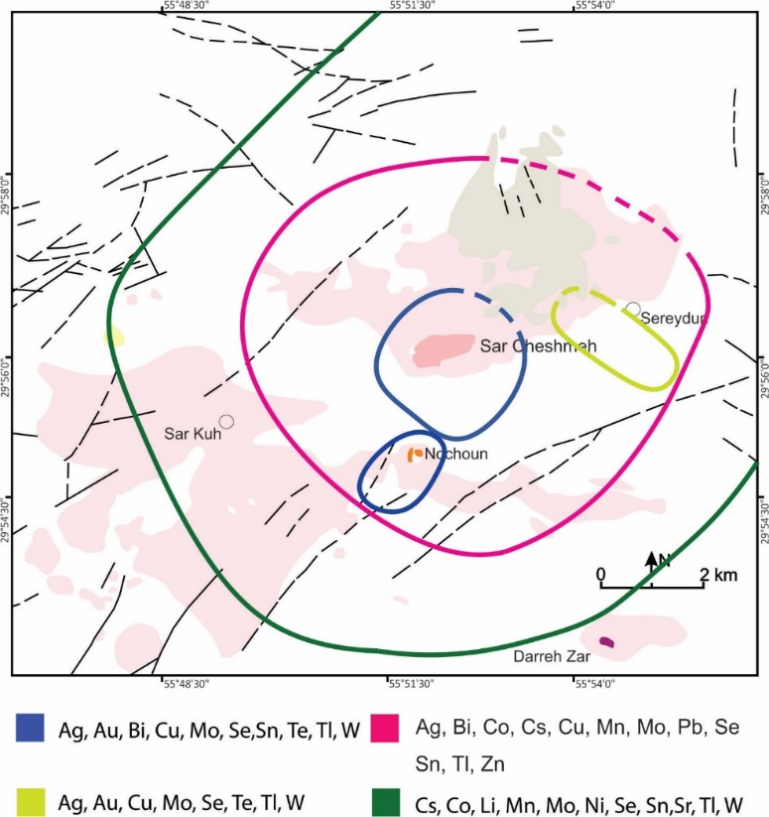
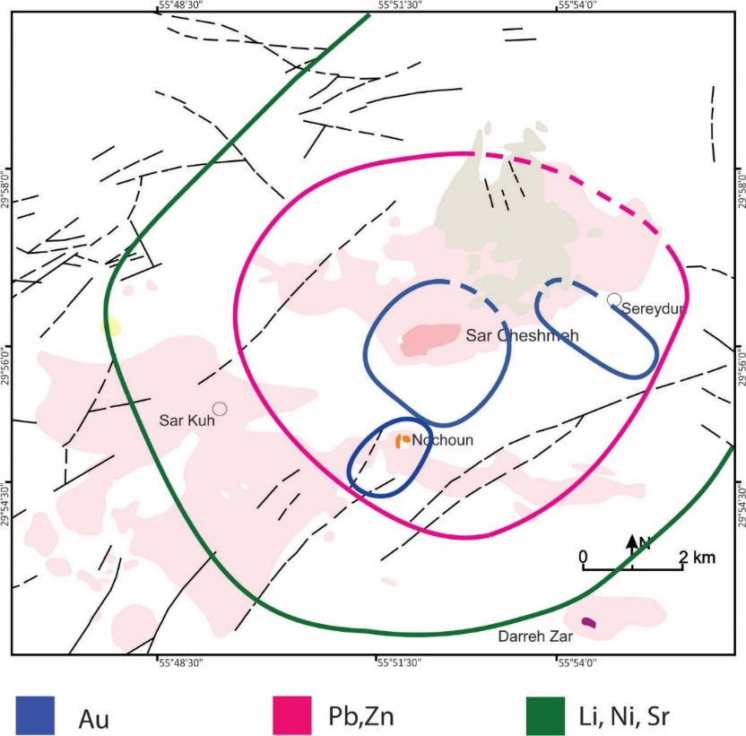
Aletaha et al. (2017)

Slide 27
PIMS (Porphyry Indicator Minerals)

Slide 28
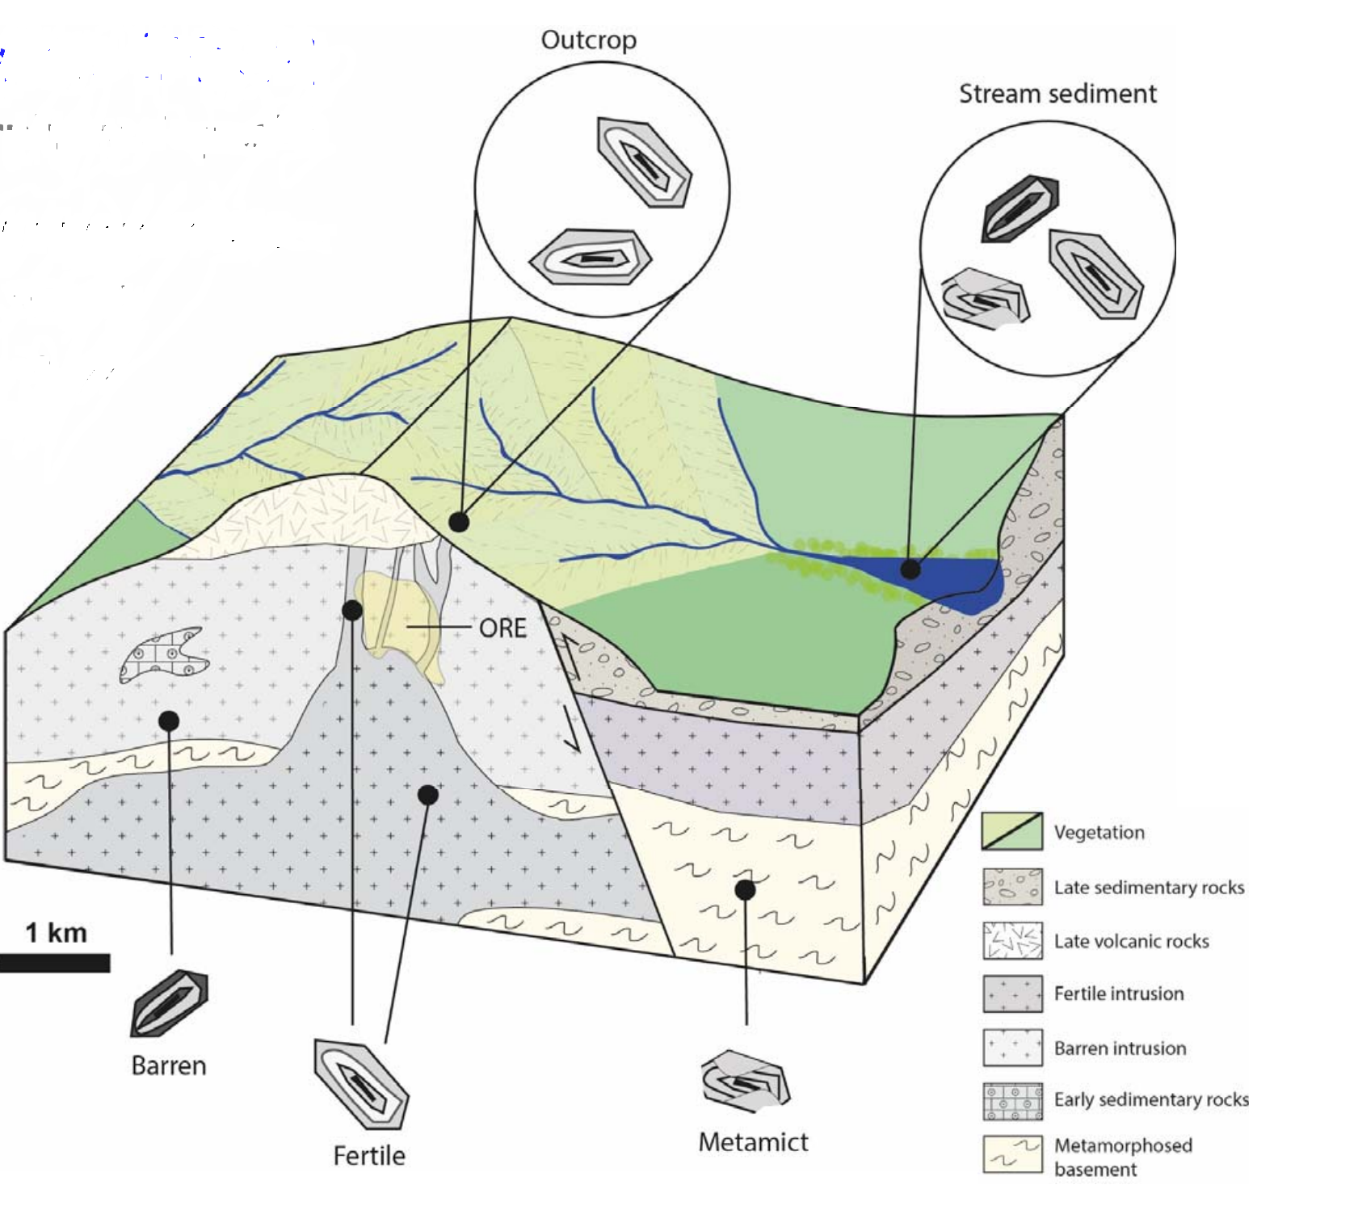

Slide 29
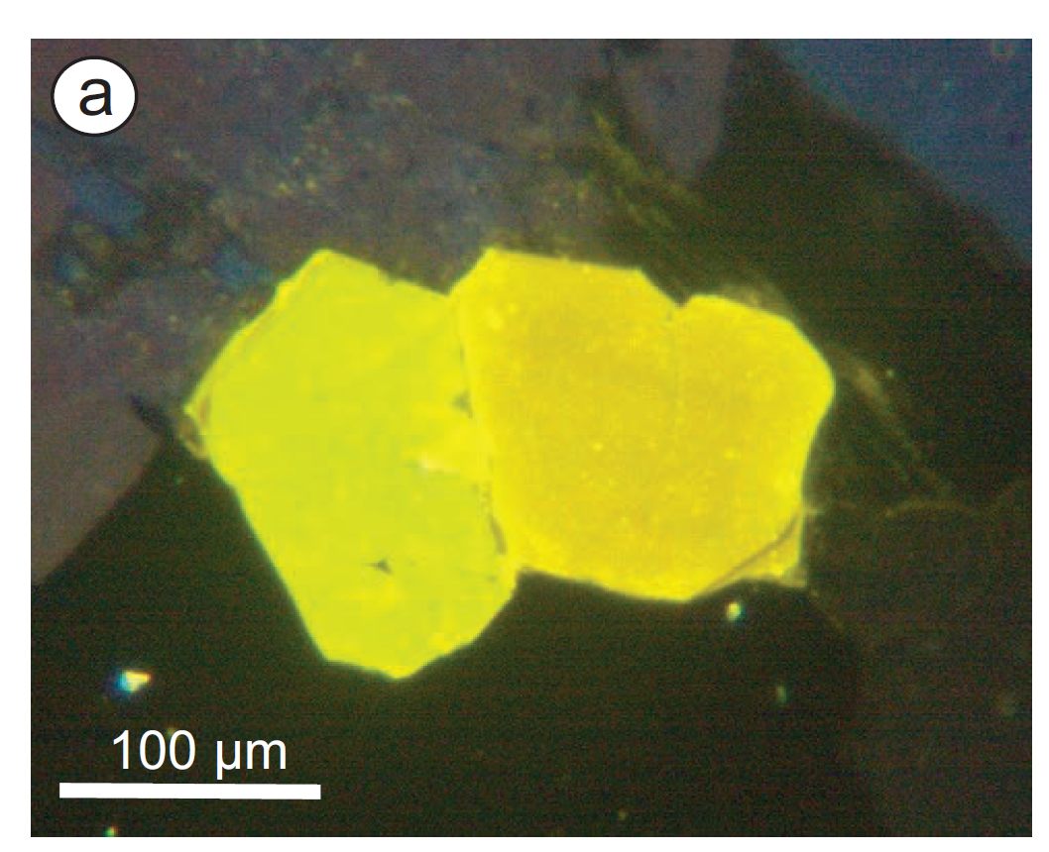
Cathodoluminescence
(MnO=0.3 to 0.5 %wt &Mn/Fe>1)
(Low Mn but higher concentrations of S&REE+Y)

Slide 30
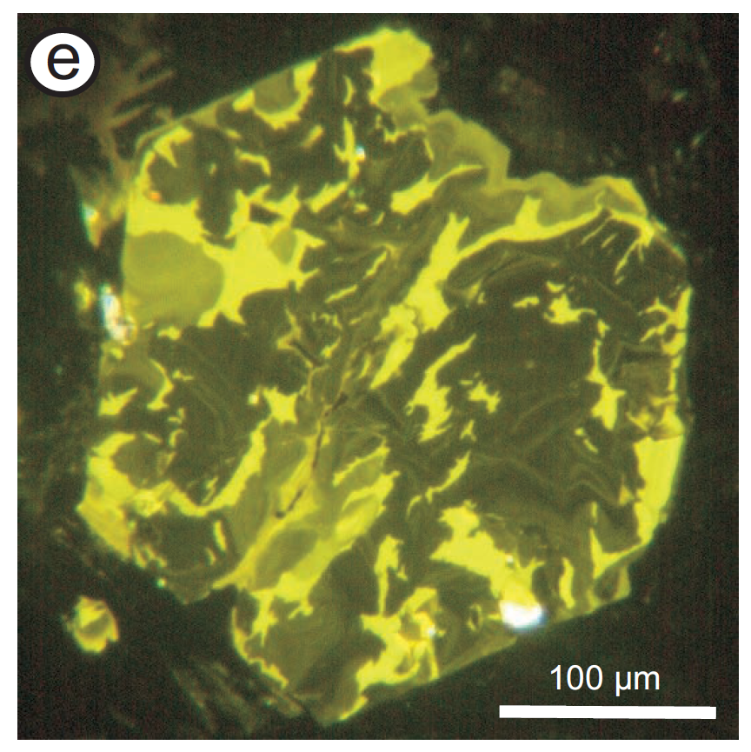
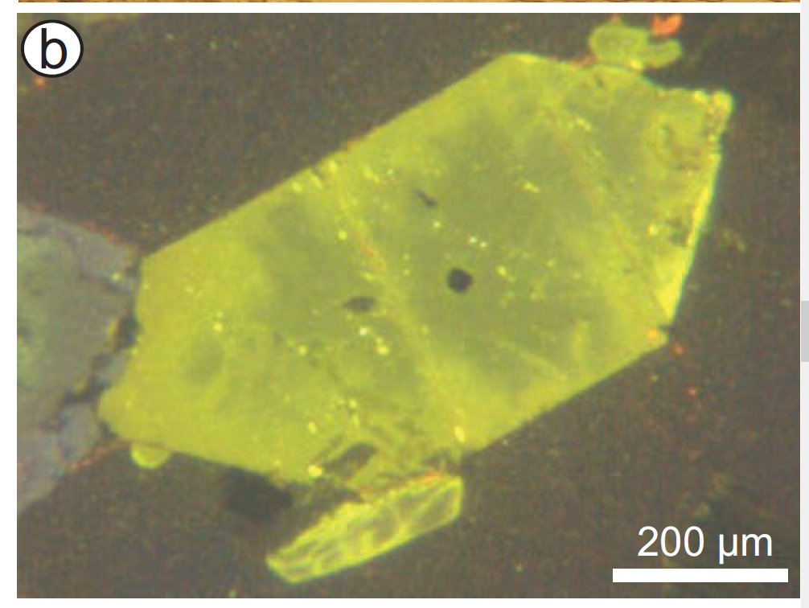
Apatite
Phyllic Alteration
Mn<0.15% with depletion in Na,S,Cl &REE
Potssic Alteration
Mn/Fe<1& depletion S,Cl,Na

Slide 31
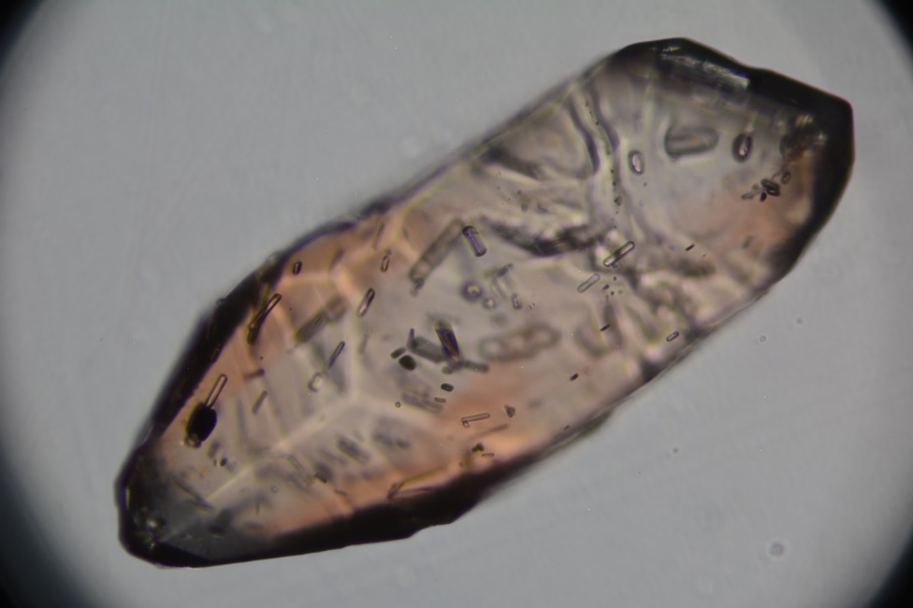
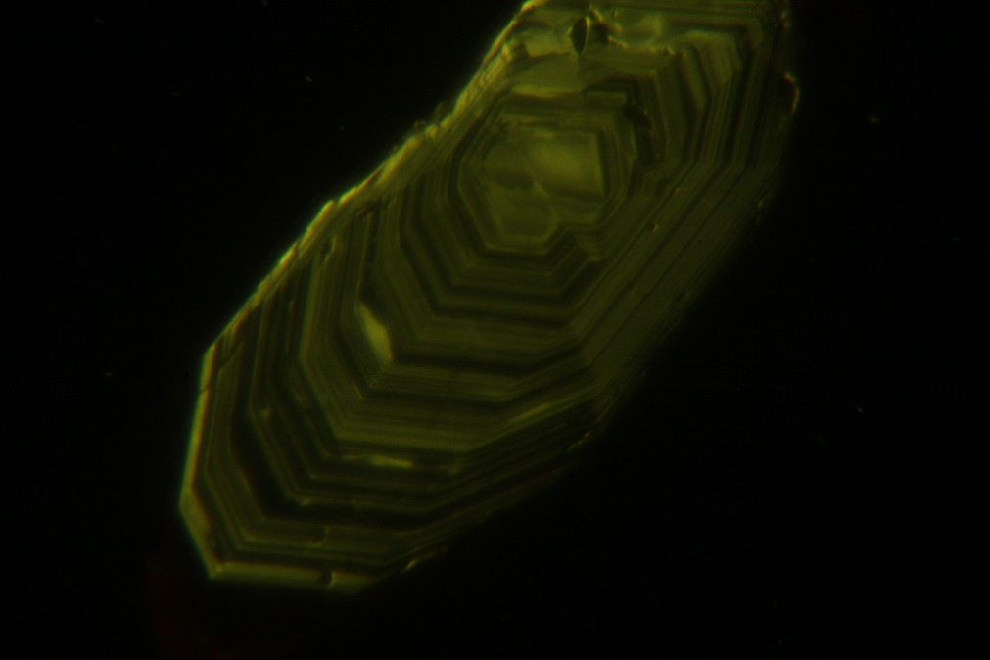
PS 1 -1-1

Slide 32
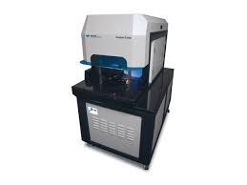
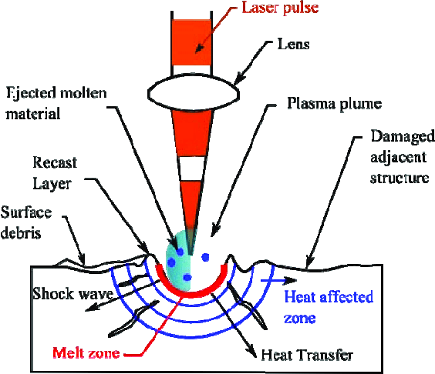
Fingerprint

Slide 33
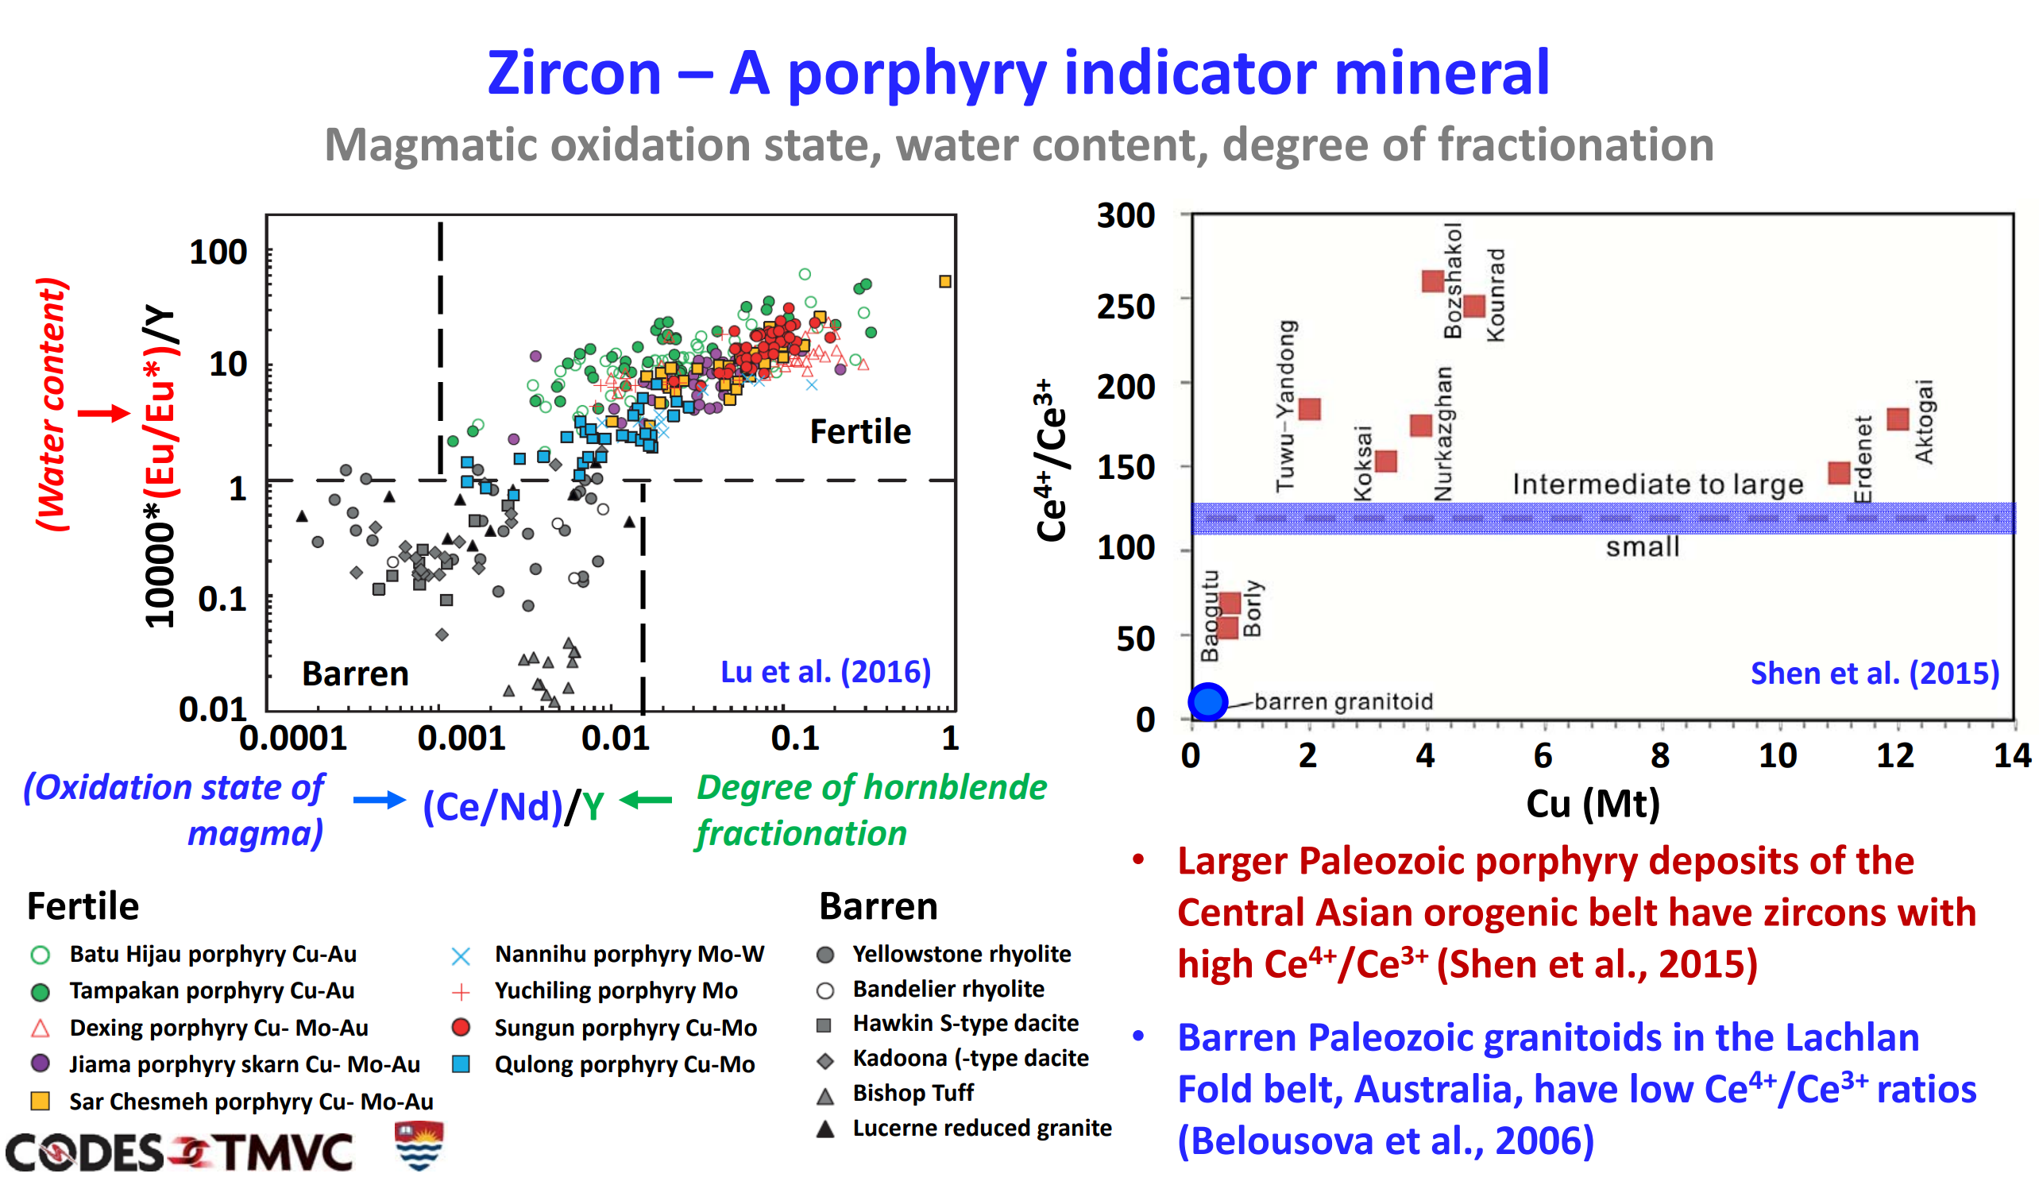

Slide 34
