Slide 1
Junior Explorers in Kazakhstan – Hurdles and Opportunities
Gold | Rare Earths | Copper

Slide 2
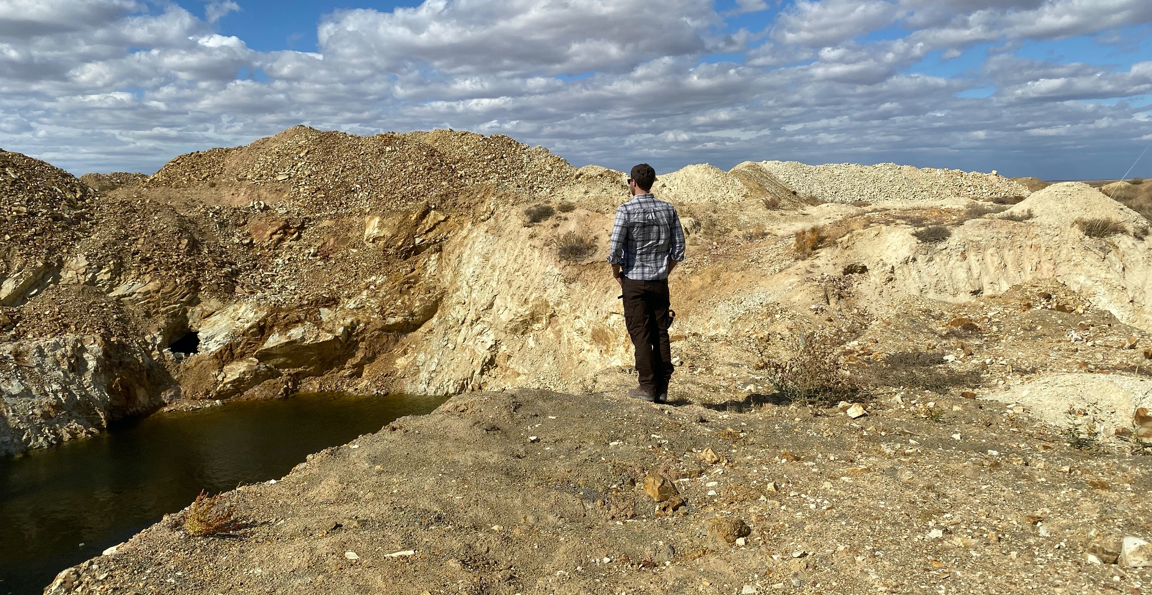
In 2019 Australia attracted:
$2.65Bn on mineral exploration
$1.06Bn on greenfields exploration
3,594,500m of drilling
Western Australia alone spent $1.65Bn (62% of the national expenditure)
“Kazakhstan today is like having all of Western Australia available to peg but in the 1970s.
The size is almost the same, the mineral law is modelled on WA, and the deposits discovered are high grade and highly profitable.
This represents a once in a lifetime opportunity.”
Alex Walker, CEO
Alex Walker overlooking artisanal workings on Apmintas Licence

Slide 3
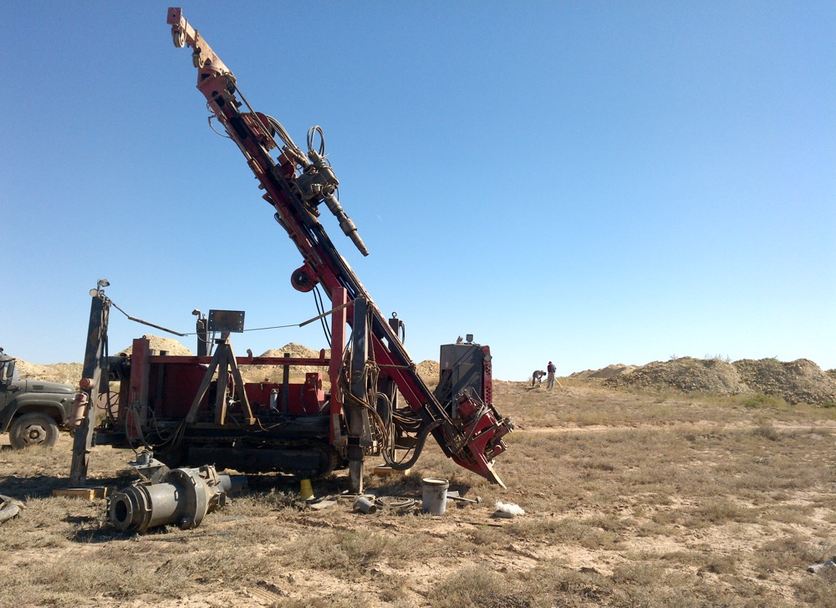
Summary
The barriers to more discoveries are easily removed and are simply delaying an inevitable outcome
Release the Data
Speed up the Process
Examples of Government Support
Opportunities 1
Opportunities 2
Drill rig on Apmintas (Sep 2021)

Slide 4
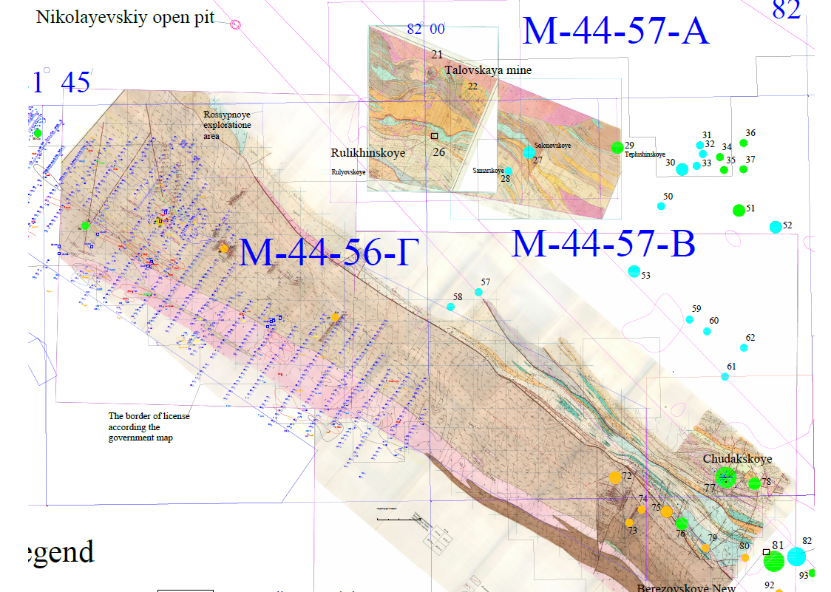
Release the data
Data is not the commodity - The commodity is in the ground
The best place to find a mine is next to (under) an old mine
Information promotes expenditure - It’s not land release that will bring junior explorers but information
Every dollar spent acquiring data and access to exploration rights is a dollar that does not go into exploration
Every day spent waiting for data and approvals is costly to junior companies
  Investors lose interest
  Company running costs absorb exploration expenditure
  Project valuations (NPV) fall due to extended development timeline
Every hour of managements time spent filing paperwork is an hour not spent on generating new ideas, assessing new projects and generating investor interest
  Data is the map to royalties, tax, employment and capital expenditure with a significant multiplier effect

Slide 5
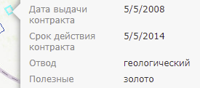
Speed up the Process
For Kazakhstan to become a top tier mining jurisdiction it first needs to better support exploration
  Licencing
  Data
  Improve the efficiency and get more applications:
    Retain licence applications to improve efficiency (EST, each application is ~517 pages, 2.58 kg’s, 5% of one tree)
    Declaration of ‘no change’ since the last licence award
    Accept international bank statements from reputable institutions for proof of funds
    Provide ‘licence status’ information to the public
    Update ‘Interactive Map’ - Remove ‘expired licences’ and publish the date they will be available to ‘peg’ or for auction
  Scan ALL documents and upload it to an open- source platform:
    The market will review and digitize this data faster than any Government body can
    This will speed up discoveries AND save the government money
    Why do we have ‘Secret’ data on awarded exploration licences?
    Publish annual exploration reports

Slide 6
Examples of Government Support
For Kazakhstan to become a top tier mining jurisdiction it first needs to better support exploration
Historical cost of data acquisition is not a good reason to charge for access
There should be a greater sense of urgency in mineral discovery and extraction due to:
  Time value of money (inflation)
  Opportunity cost (global capital allocated elsewhere)
  A stronger economy creates the capacity for social support systems AND less need for these systems
Canadian Government is investing up to C$3.8B into its critical minerals strategy
Australian Government is investing A$2bn boost to critical minerals
Australian Government Junior Mineral Exploration Incentive - $100 million over four years
Accelerating Commercialisation initiative - A$12m in grants to encourage invention in mining
$225 million in the Exploring for the Future program, led by Geoscience Australia

Slide 7
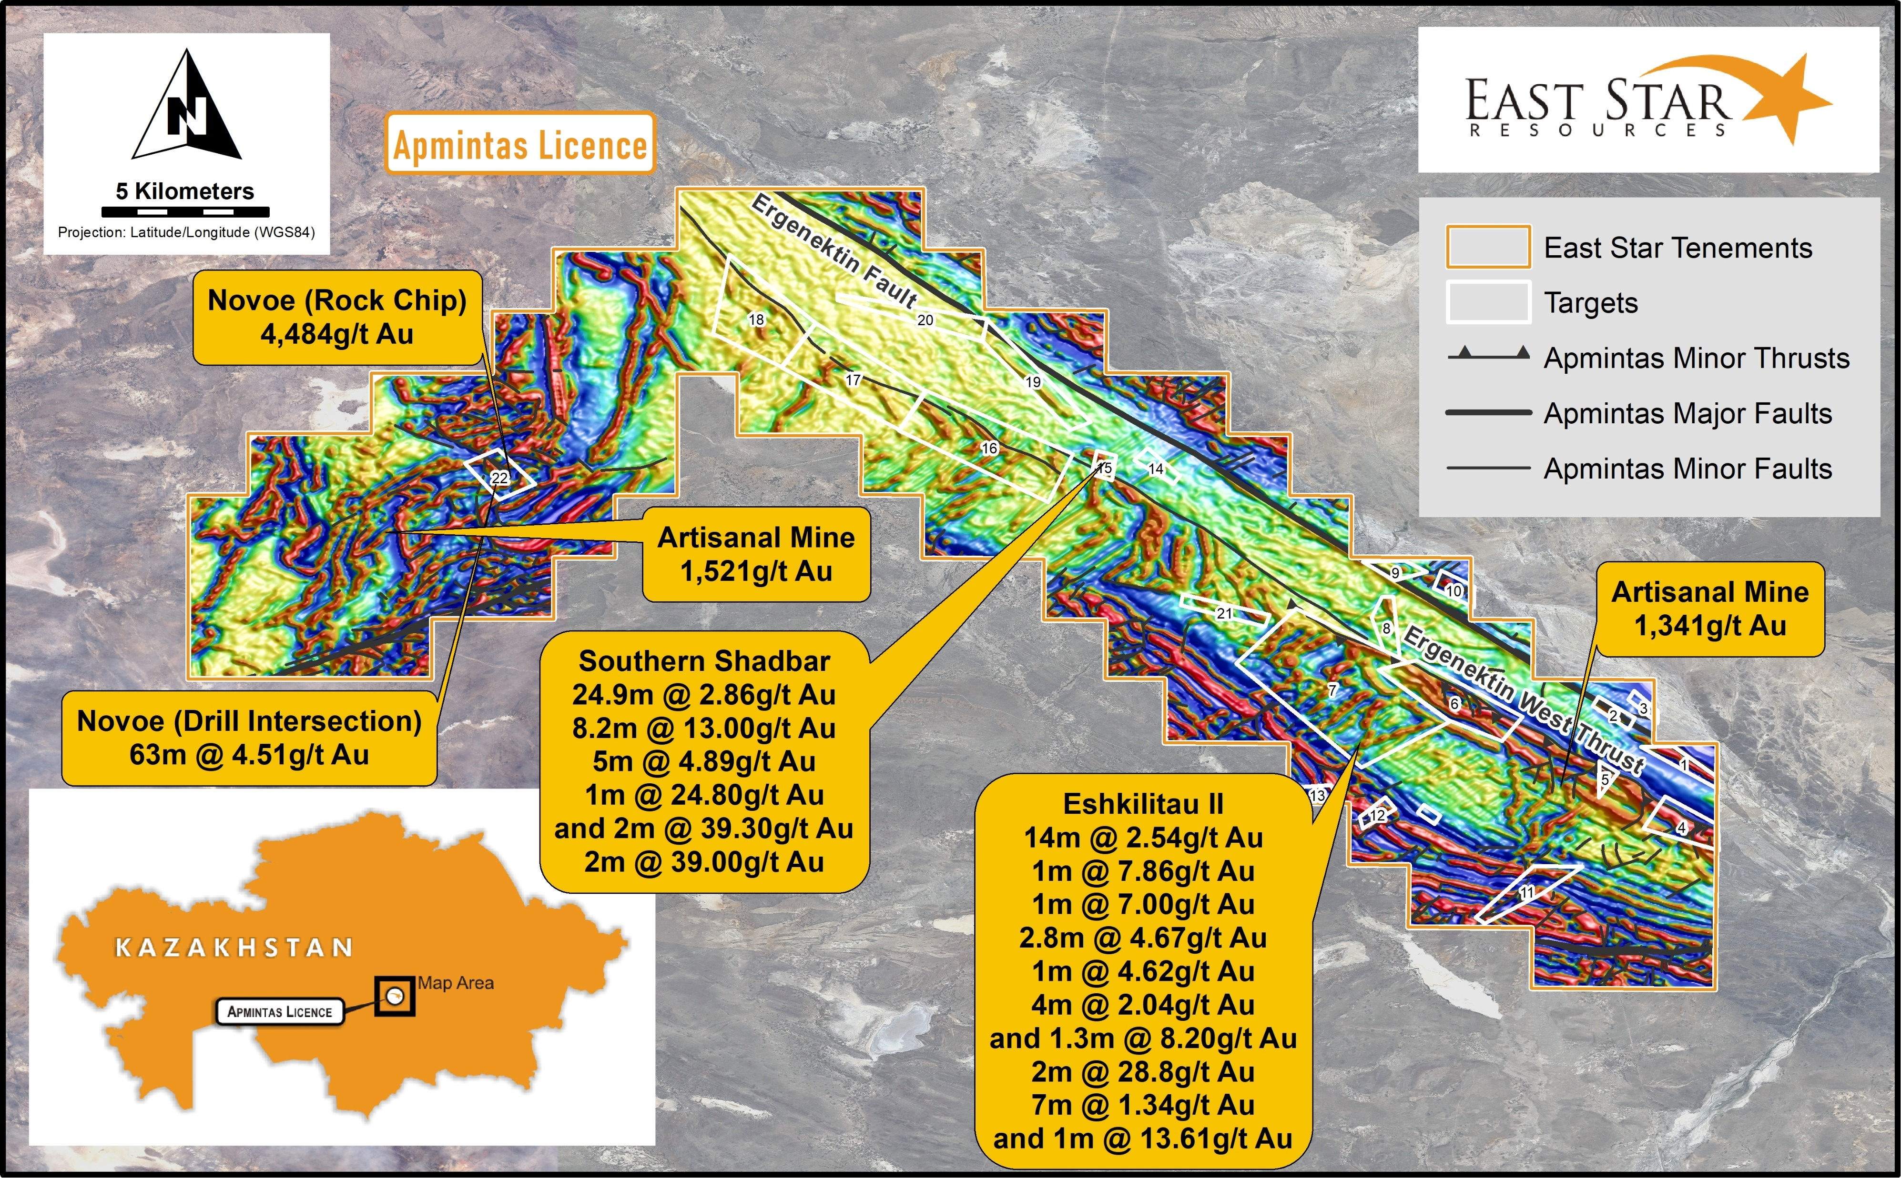
Opportunities - 1
Licences on known mineral belts with historical workings and some data
Ownership (Joint Venture) Size
80% EST / 20% TKS 259 km²
Prior to Licence acquisition
Rock chips results
Satellite Google Images
1:200,000 scale maps
Since Licence Acquisition
3,127m RC drilling resulting in 63m @ 4.51 g/t gold at Novoe target and 14m @ 2.54 g/t Au at Eshkilitau II target
4,567 line km of magnetics – 22 targets identified, 9 with historical gold occurrences and 9 with geochemical anomalies of gold pathfinders
Historical data was received AFTER drilling showing intersections of:
  24.9m @ 2.86 g/t Au and 2m @ 39.3 g/t Au from 28m at Southern Shabdar target
  7m @ 1.34 g/t Au and 2m @ 28.8 g/t Au at Eshkilitau II target
Peak Grab Samples

Slide 8
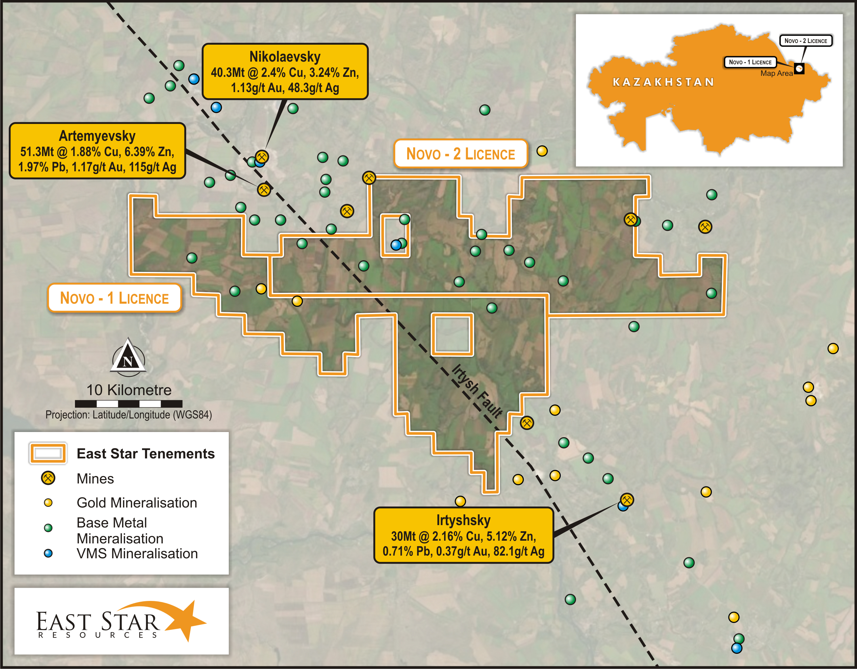
Opportunities - 2
Areas already available along strike from world class mines!!!
Ownership (Joint Venture) Size
80% EST / 20% TKS 693 km²
Famous Volcanogenic Massive Sulphide (VMS) belt hosting several world class mines with a total endowment of ~1,000 Mt in 58 deposits
Limited exploration since late 1980’s
Existing transport, power and processing infrastructure lowers development hurdles
Name | (Mt) | Cu (%) | Pb (%) | Zn (%) | Au (g/t) | Ag (g/t)
Ridder–Sokol’ny (Leninogorsk Mine) | 224.5 | 0.39 | 0.78 | 1.66 | 2.61 | 25.6
Zyryanovsk/Zyryanovskoye | 125 | 0.4 | 2.7 | 4.5 | 0.13 | 20
Chekmar/ Chek mar | 106.7 | 0.25 | 0.78 | 2.13 | 0.27 | 12.1
Tishinka/Tishinskoye | 60 | 0.5 | 0.9 | 5.3 | 0.9 | 15
Grekhovka | 59 | 0.4 | 1.4 | 2.8 | 0.1 | 20
Novoleninogorsky/Novo-Leninogorsk | 53.4 | 0.16 | 1.43 | 4.04 | 1.54 | 32.8
Artem’evsk/Artemyevsky | 51.3 | 1.88 | 1.97 | 6.39 | 1.17 | 115
Maleevsky | 50 | 2.3 | 1.3 | 7.5 | 0.75 | 75
Orlovka/Orlovskoye | 48 | 4.7 | 0.9 | 3.2 | 0.8 | 47
Novo-Zolutushinskoye | 48 | 4.7 | 0.9 | 3.2 | 0.8 | 47
Nikolaevka/Nikolayevskoye | 40.3 | 2.4 | 0.43 | 3.24 | 1.13 | 48.3
Irtysh/Irtysky | 30 | 2.16 | 0.71 | 5.12 | 0.37 | 82.1
Belousovka/Belousovskoye | 30 | 1.1 | 1.15 | 4.74 | 0.38 | 51.3
Korbalikha | 25 | 1.46 | 2.01 | 9.81
Dolinsky/Dolinnoye | 22 | 0.43 | 0.5 | 1 | 2.67 | 13.7
Kamyshinskoye | 15 | 2.64 | 1.05 | 2.77
Rulikha | 14.3 | 1.18 | 0.44 | 3.58 | 0.28 | 13.5
Farmland on the Novo Licences
Top deposits - Lobanov, 2014

Slide 9
THANKYOU
Transport for the field camp during drilling

